Slide 1








Delhi Public School, Hyderabad
Model United Nations 2024

Slide 2


What is Model United Nations (MUN)?
Academic Simulation of the United Nations.
Debate and problem-solving related to global issues.
Following the procedures of the United Nations (Rules Of Procedure).
Students take on the role of ‘delegates’, representing various countries.
To solve the question/agenda at hand through resolutions.
Participants research and develop positions on the question/agenda at hand.

Slide 3


Committees simulated at DPSHMUN’24
United Nations Security Council (UNSC)
United Nations Human Rights Council (UNHRC)
All India Political Party Meet (AIPPM)
The Economic and Financial Committee (ECOFIN)
Indian Premier League (IPL)
Futuristic Continuous Crisis Committee (FCCC)\
United Nations Commission on Narcotic Drugs (UNCND)
The Legal Committee
International Press (IP)

Slide 4


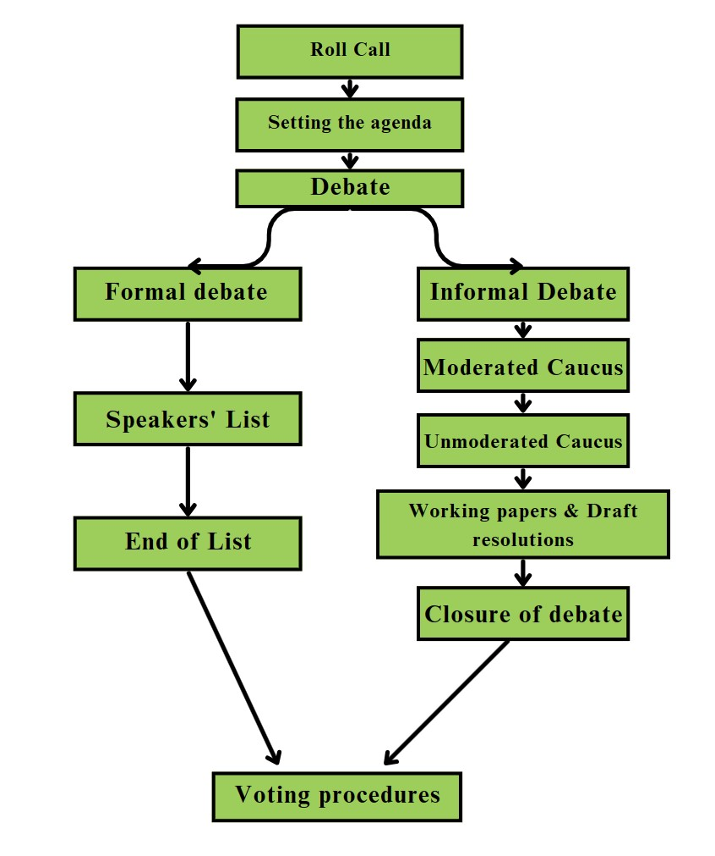
Flow of
Debate

Slide 5


Rules of Procedure (ROP)

Slide 6


Roll Call and Commencing Debate
On each day of the conference Roll Call will be taken by the Executive Board.
When called upon, a delegate may answer with a the following:
Present
Present and voting
After roll call, a motion to set the agenda is required.

Slide 7
Types of Debate
Debate is divided into 2 parts:
Formal Debate: General Speakers List
Informal Debate: Moderated Caucus & Unmoderated Caucus

Slide 8
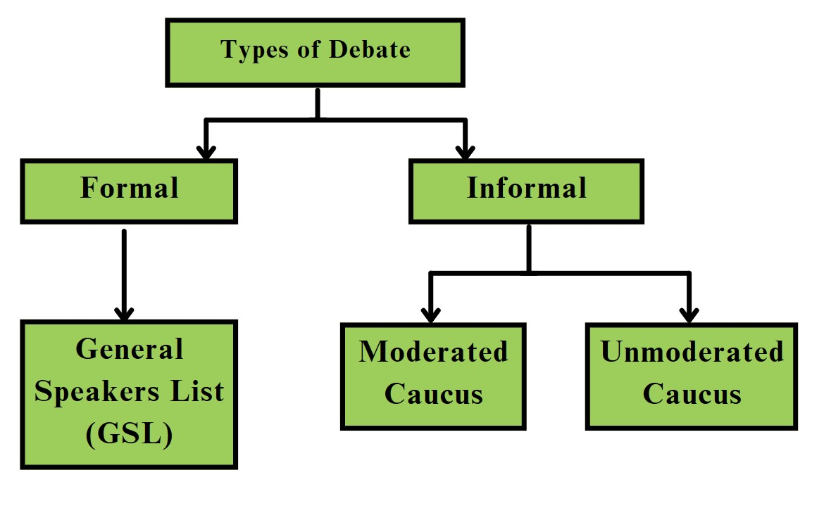
Types of Debate

Slide 9
General Speakers List (GSL)
A physical inexhaustible list of the order of speakers.
Speeches here do not need to have a specific topic and can address any and all parts of the agenda.
A motion is to be raised after the setting of the agenda to establish the GSL.

Slide 10
General Speakers List (GSL)
Speaking time can be set to 60, 90 or 120 seconds.
A delegate can be added to the list by raising their placard or sending a note to the EB.
Delegates may speak an unlimited number of times through the GSL but cannot be added if their name is already there on the list.

Slide 11
Yields
If there is time remaining once a delegate concludes their speech, they must yield the remaining time. The remaining time may be yielded to the following:
Yield to the Executive Board (Time is absorbed or used at the discretion of the EB)
Yield to Points of Information (To entertain questions from other delegates)
Yield to another delegate (Allocates time for another delegate to speak)

Slide 12
Yields
4. Yield to Comments (To entertain comments on the speech made by the delegate)
Delegates may only yield their time in the General Speakers List.
Points may not be raised upon speeches made in yielded time.
Time, once yielded, cannot be yielded again.

Slide 13
Moderated & Unmoderated Caucuses
A motion to suspend formal debate is required to move into informal debate.
Moderated Caucus:
Delegates are allowed to make short and focused arguments on specific topics of the agenda.
A motion is raised for a specific period of time, which is considerably shorter than the GSL.
A motion to enter a moderated caucus must include a topic, total duration, and individual speaker time.

Slide 14
Motions
Motions move the committee from one part of the flow of debate to another.
All motions must be voted upon by the entire committee, and only if the required majority vote in favor of the motion, it is passed and executed
Certain verbatim is to be followed while raising a motion in committee, and certain details are to be included mandatorily.

Slide 15
Motions
Motions are voted upon based on 2 orders:
Order of Precedence: If multiple motions have been raised that are of the same disruptivity, they are voted upon in the Order of Precedence, i.e. the order that they have been raised in.
Order of Disruption: The most disruptive, i.e. time consuming motions are considered first. Disruptiveness is defined by the nature of the motion (unmoderated caucuses are generally seen as more disruptive than moderated caucuses) and its length (a 20-minute moderated caucus is more disruptive than a 15-minute one).

Slide 16
Points
Points allow delegates to ask questions, express discomfort, and communicate with the EB.
They are of four types:
Point of Inquiry is raised by a delegate when they wish to ask a question regarding the procedure or proceedings of the committee. Points of Inquiry may not interrupt a speaker and are answered by the Executive Board.
Point of Order is raised by a delegate when they believe the dais has made a procedural error. It may also be raised to point out factual and logical inaccuracies in statements made by other delegates.

Slide 17
Points
3. Point of Personal Privilege is raised by a delegate to express their personal discomfort. Only this Point can interrupt a speaker. Grievances such as the temperature of the room or the inability to hear a speaker can be brought up using this Point.
4. Point of Information is raised when a delegate has a question for a speaker during a formal debate. Points of Information can be raised in informal debate through chits.
Points may not be raised upon other points.

Slide 18
Chits
Chits are a mode of non-verbal communication used between delegates during formal sessions.
Informal chits may be sent to another delegate directly by mentioning the sender and recipient only.
Formal chits that require the attention of the EB may be sent to another delegate via the Executive Board.
Chits are passed between delegates and the Executive Board by Organizing Committee members.

Slide 19

Documentation

Slide 20
Working Papers & Draft Resolutions
Working Papers:
The first stage of a resolution is in the form of a Working Paper.
The committee discusses the Working Papers and subsequently moves to create Draft Resolutions.
Working papers are concrete in that they are relatively formal, yet they are also flexible because the format of resolutions does not bind them.
They are usually rougher versions of resolutions.

Slide 21
Working Papers & Draft Resolutions
Draft Resolutions:
A resolution is the main outcome document of the UN and MUN.
A resolution is essentially a document that lists various solutions and undertakings towards solving or addressing a particular issue or problem.
Resolutions guide the work of the UN, its agencies and Member States, and as such, have extreme importance.

Slide 22
Working Papers & Draft Resolutions
Draft Resolutions are assigned numbers based on the order in which they were received by the Executive Board.
A resolution before being passed through a voting procedure is known as a Draft Resolution.
Resolutions have a particular format and are divided into 2 sections: the preambulatory clauses and the operative clauses.

Slide 23
Preambulatory & Operative Clauses
Preambulatory Clauses:
Preambulatory Clauses of a resolution provide context and help interpret the rest of the document.
All the preambulatory clauses begin with a pre-approved clause word. These clauses serve to justify solutions proposed in the resolution and do not call upon or take action themselves.
They are not numbered and always end with a comma.

Slide 24
Preambulatory & Operative Clauses
Operative Clauses:
Operative Clauses consist of actionable ideas, directives and undertakings towards solving the problem/issues/agenda at hand.
They are numbered and end with semicolons.
All the operative clauses begin with a pre-approved clause word.
They are the main substance of a resolution.
Only the last operative clause in a resolution should end with a period
Sub-clauses are indicated by a lowercase letter and sub-sub clauses are indicated by Roman numerals.

Slide 25
Sponsors & Signatories
Sponsors:
Sponsors are delegates who have contributed to Draft Resolutions substantively.
They are the principal authors of the document and agree with its substance.
Sponsors are required to present their document to the committee in a specified format.

Slide 26
Sponsors & Signatories
Signatories:
Signatories are delegates who may or may not agree with the substance present in a document, but still wish to see it debated and discussed in committee.
A certain percentage of the committee must be signatories for a document to be accepted.
Signatories may propose amendments for a Draft Resolution.

Slide 27
Amendments
If a delegate wishes to improve/amend a Draft Resolution, they may propose an amendment.
On the basis of the action that the amendment is taking, there are three types of amendments:
Addition amendment which allows for the addition of a new clause to the resolution
Deletion amendment which allows for the deletion of a particular clause from the resolution
Modification amendment allows for the modification of a particular clause in the resolution

Slide 28
Amendments
On the basis of the nature of the amendment, as deemed by the sponsors, there are two types of amendments:
Friendly Amendments are those that are considered friendly by the Sponsors who agree that the amendment should be made to the document without debate.
Unfriendly Amendment is an amendment that is considered unfriendly by even one of the Sponsors as they believe it should not be incorporated into the document. Unfriendly amendments are put to vote and if a majority of the committee is in favour of the amendment, it is incorporated into the document despite the disapproval of the Sponsors.

Slide 29

Any Points of Information?

Slide 30
Good Luck!

